Slide 1
Application of computer in scientific writing
Krishna Misra
IIITA, Prayagraj
12-10-2021

Slide 2
Importance of computer learning
Basic knowledge of computers is a must for any scientific writing

Slide 3
Problems of Technical Writing in Pre-computer era
First draft was hand written
Conversion of first draft to electronic form was through typewriter
Manual proof reading and error correction required repeated retyping of whole document.
Hand drawn figures were very difficult to prepare and tediously converted into electronic forms.
Collection of literature was also cumbersome and included thorough library searches and laborious literature reading to extract the useful information.

Slide 4
Computational tools=> Accelerated Technical writing
Easy Collection of Literature: Search Engines
Computational Tools have made life easier: Most popular tools for preparing text and figures in technical writing are:
Text Writing tools:
Microsoft Word=> Ultimate tool for writing text, making flow charts, fanciful text representation.
LaTeX for writing scientific papers
Adobe reader=> Offered a convenient way to represent papers for reading, printing and sending via mail.
Picture making/editing tools
Paint=> Simple tool with endless applications.
Adobe Photoshop=> Useful in image enhancement and designing.

Slide 5
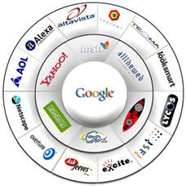
Search Engines

Slide 6
Scientific Search engines
Google Scholar (http://scholar.google.com/)
Google Scholar is a free academic search engine that indexes academic information from various online web resources.Founded in 2004, it is one of the widely used academic resources for researchers and scholars.
Google Scholar citation index generator : Google Scholar Citations lets you track citations to your publications over time.
Google H-Index for see citation ration of a author
Microsoft Academic Research (http://academic.research.microsoft.com/):
Microsoft academic research is yet another top search engine for academic resources. Developed by Microsoft Research, it has more than 48 millions publications written by over 20 millions authors.
PLOS ONE (http://www.plosone.org/):
Founded in 2006, PLOSE ONE provides a free access platform to everyone searching for science-related information.
ScienceDirect (http://www.sciencedirect.com/):
“A leading full-text scientific database offering journal articles and book chapters from more than 2,500 journals and almost 20,000 books.”

Slide 7
Scientific Search Engines
GetCITED (http://www.getcited.org/):
GetCITED is another powerful tool for searching scientific information. It is an online academic database that indexes academic journals and citations
Bioline International (http://www.bioline.org.br/):
Bioline is among the most trusted and authentic search engines that has peer-reviewed academic journals on public health, food and nutritional security, food and medicine and biodiversity.
Refseek:
With a database of over one billion documents, web pages, books, journals, newspapers, online encyclopedias and articles, Refseek is your ultimate companion for academic research.
Scopus is Elsevier's abstract and citation database launched in2004 .It covers three types of sources: book series, journals, and trade journals including patent databases The largest abstract and citation database of research literature and quality web sources covering nearly 18,000 titles from more than 5,000 publishers.

Slide 8
Who discovered Google?
Google LLC (limited liability company)is an American multinational technology company that specializes in Internet-related services and products, which include online advertising technologies, search engine, cloud computing, software, and hardware.
Google Inc. has now changed to Google LLC (limited liability company)
Google was founded in 1998 by Larry Page and Sergey Brin while they were Ph.D. students at Stanford University, California.
Together, they own about 14 percent of its shares and control 56 percent of the stockholder voting power.

Slide 9
History
In 1995 Sergey Brin, a 21-year-old student at Stanford University, took University of Michigan graduate Larry Page, just a year older, on a tour of the campus.
Legend has it that the two disliked each other and bickered the entire tour.
But it must not have been a complete disaster because Page enrolled in Stanford and began working to fulfill the requirements of his Ph.D. program in computer sciences.

Slide 10
Search Engines Cont..
Google Scholar: Provides a search of scholarly literature across many disciplines and sources, including theses, books, abstracts and articles.
h-INDEX: The h-index is an index that attempts to measure both the productivity and impact of the published work of a scientist or scholar.
Also known as the Hirsch factor; (Hirsch, 2005), an indicator created by Jorge E. Hirsch, that attempts to measure the achievements of a research scientist.
The h-index is based on the set of the scientist's most cited papers and the number of citations that they have received in other publications.

Slide 11
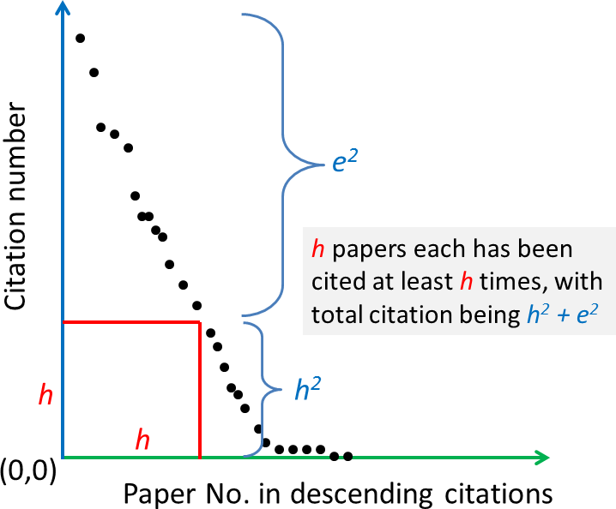
h -index

Slide 12
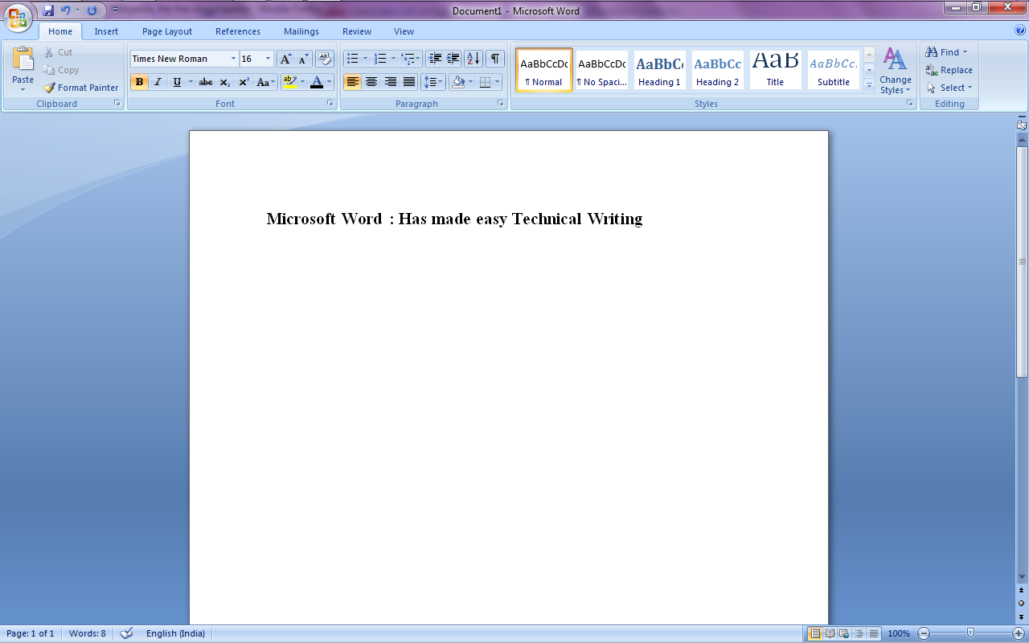
Microsoft Office Word
It is an excellent word processing tool which can be used to type letters, reports, and other documents. It provides the ability to use the computers for technical writing and publishing.
Basic features:
Writing:
Type, Backspace, Delete, Insert and Overtype.
Cut or Copy and Paste, Create AutoText
Line Numbering
Page numbers and date
Text Formatting:
Bold, Italicize, and Underline
Use Spell Check
Find and Replace
Change the Font Size
Change the font type.
Text Alignment: left/right/center/justified.
Page layouts and margins setting
Page layouts
Set the Orientation
Set the Page Size
Set the Margins
Add Page Numbers
Insert Page Breaks
Preview and Print Documents

Slide 13
Formatting Paragraphs and Working with Styles
When you type information into Microsoft Word, each time you press the Enter key Word creates a new paragraph. You can format paragraphs.
For example, you can indent the first line of a paragraph, you can set the amount of space that separates paragraphs, and you can align a paragraph left, right, centre, or flush with both margins.
Styles are a set of formats you can quickly apply to a paragraph .By applying a style, font and font size can be set, paragraphs can be aligned all at once Formatting options may be:
Add Sample Text
Add Space Before or After Paragraphs
Change Line Spacing
Create a First-Line Indent
Indent Paragraphs
Align Paragraphs
Create a Hanging Indent
Choose a Style Set
Apply a Style
Change Style Sets

Slide 14
Special Features of Microsoft word
Word has a built-in spell checker, thesaurus dictionary, Office Assistant and utilities for transferring, copy, pasting and editing text
WordArt:
WordArt enables drawing text in a Microsoft Word document such as a title, watermark, or other text, with graphical effects such as skewing, shadowing, rotating, stretching in a variety of shapes and colors and even including three-dimensional effects.
Bullets and numbering:
Word has extensive list of bullets and numbering features used for tables, lists, pages, chapters, headers, footnotes, and tables of content. Bullets and numbering can be applied directly or using a button or by applying a style or through use of a template.
AutoSummarize
AutoSummarize highlights passages or phrases that it considers valuable. The amount of text to be retained can be specified by the user as a percentage of the current amount of text.
Creating tables
Users can also create tables in MS Word. Depending on the version, Word can perform simple calculations. Formulas are also supported .

Slide 15
Microsoft Office Excel
Microsoft Excel is a spreadsheet application which is widely used for processing statistical data and its presentation.
It offers very handy tool incorporated with battery of supplied functions for statistical and mathematical calculations, graphing tools, pivot tables.
It can display data as line graphs, histograms and charts, and with a very limited three-dimensional graphical display.
Excel application can automatically poll external databases and measuring instruments using an update schedule, analyze the results, make a Word report or Power Point slide show, and e-mail these presentations on a regular basis to a list of participants.

Slide 16
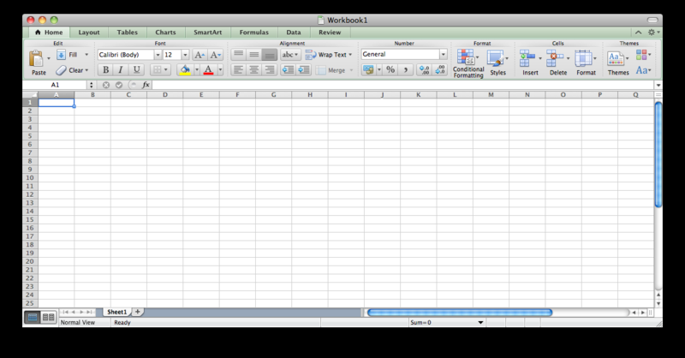
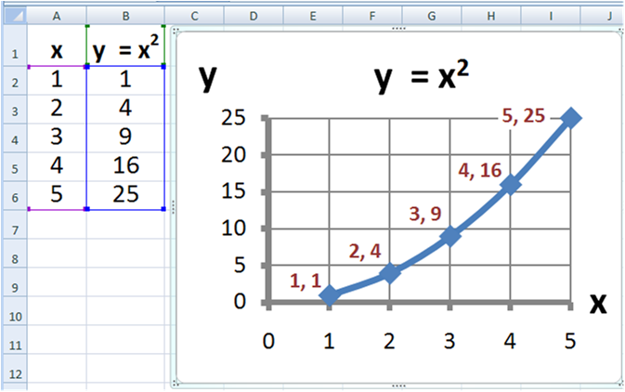

Slide 17
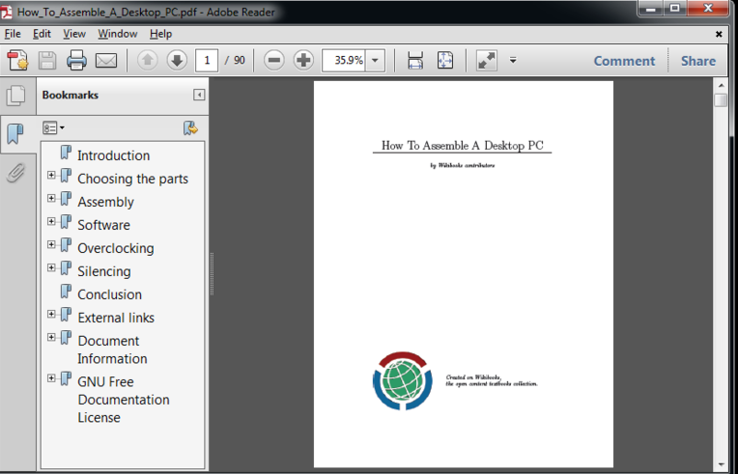
Adobe reader
Adobe Acrobat is a family of application software developed by Adobe Systems to view, create, manipulate, print and manage files in PDF.
PDF stands for "portable document format". Essentially, the format is used when you need to save files that cannot be modified but still need to be easily shared and printed.
It is available as freeware and can be downloaded from Adobe's web site.
Acrobat and Reader are widely used as a way to present information with a fixed layout similar to a paper publication.

Slide 18
Open source file format
IrfanView seeks to create unique, new and interesting features : It is free for non-commercial use, 32-Bit(4byte) graphic viewer for Win 9x/ME/NT/2000/XP, with multiple (animated) GIF (Graphic interchange format) support and Multipage TIFF ( Tagged Image File Format) support.
Ghostscript: Ghostscript is a suite of software based on an interpreter for Adobe Systems' PostScript and Portable Document Format (PDF) page description languages.
MiKTeX project: MiKTeX is a typesetting system for the Windows operating system.

Slide 19
GIF (Graphic Interchange Format
In the early days of the web, the GIF (a computer file for sending images)was widely used because of its ability to compress images into very small file sizes.
As people started to adopt cable and DSL(Digital subscriber line ) connections over time, the popularity of GIFs gave way to JPEGs, which are larger files, but boast better image quality than GIF.
But GIF has made a comeback , because of animated GIFs: – small image files that load quickly and are essentially looping mini-movies.
BENEFITS: Small file size allows for quick loading.
DRAWBACKS: Standard GIFS can only render from a 256 color palette; are not suitable for use in professional applications like publishing.

Slide 20
JPEG (Joint Photographers Expert Group)
Most popular image format
JPEG is a compressed image format which drops unneeded color information that can’t be detected by the human eye This is known as lossy compression and is what allows JPEG to achieve such small file sizes.
JPEGs work best when dealing with photographs with smooth variations of color. It is not a good choice for textual documents or documents with solid color objects as the sharp lines between colors will create artifacts in the image, causing the text or objects to have a ringed appearance.
BENEFITS: Most widely-used image type, widely adaptable. Compression can be adjusted to achieve a balance between the quality of the image and the file size.
DRAWBACKS: JPEGs use lossy compression which means that image quality is lost in exchange for size; not suitable for text documents.

Slide 21
PNG (Portable Network Graphics
PNG is a lossless compressed format, which makes it good for both photographs and text documents. A PNG will generally be larger than a JPEG, and sometimes smaller than a TIFF.
Interestingly, it was originally developed to replace the GIF, but the formats are drastically different.
PNG supports more colors than GIF images as well as improved transparency. It is a useful format for line graphics and wordmarks as the lines and text will show up crisply and cleanly in the output image.
BENEFITS: Compress images without losing quality; suitable for text documents.
DRAWBACKS: Larger file size than JPEGs; not suitable for professional quality print graphics.

Slide 22
TIFF FORMAT
Like PNG, TIFF can be a lossless format, which means that essentially, what you see is what you get.
It is commonly used in the layout of newspapers, magazines and the like, because a TIFF (or TIF) will appear on the printed page just as it appears on a computer monitor.
That also makes it a good choice for scanned documents – and actually, that’s exactly what the format was first developed for in the 1980s.
BENEFITS: Can have more than one page per file (multipaged); can be lossless to allow editing and re-saving without losing image quality; the choice of document archiving and publishing professionals worldwide.
DRAWBACKS: Not all TIFF image viewers support viewing multipage TIFF images.

Slide 23
Other Formats
BMP (Bitmap): This is an old image format that is still used on rare occasions, but mostly has been surpassed by other formats that are more useful in the modern computing environment.
Vector images or vector graphics (variety of file extensions): These are images that are composed of paths, with a start and end point, and other points along the way to describe lines, squares, arcs and curves to create simple or complex images. This allows them to be scaled to virtually any size with no loss in quality.

Slide 24
Difference between Vector and Raster files
Raster files use thousands of pixels to build an image. Each pixel (0.26mm) has a colour. These pixels are put together like a jigsaw puzzle to create your image/ logo.
Common files which use Raster images are JPG, GIF and PNG files.
Raster image cannot be resized.
When you resize a raster image, each pixel is equally resized and becomes fuzzier as you increase in size.
Down scaling your image won’t effect the quality of your raster file, increasing it above it’s original size will.

Slide 25
Vector Files
More flexible and rely on mathematical equations
Flawless image quality.
Most commonly used with graphic designers, and
With the software from Adobe Illustrator, which specializes in vector work.
Your logo and all other branding items should be designed in vector formats.
Branding elements like your logo can be rescaled to fit supports of any size without losing image quality.
The other good thing about vector file is that they can be converted to JPG and PNG formats very easily for usage on the web so you get the best of both worlds.

Slide 26
Other interesting text editors
LyX – An open source cross-platform word processor
Texmaker – An open source cross-platform editor and shell (operating system).
TeXnicCenter – An open source Windows editor and shell
MeWa – An open source Windows editor based on TeXnicCenter
WinShell – A Windows freeware, closed-source multilingual integrated development environment (IDE)
#All of the above has been designed for LINUX platform

Slide 27
Digital Artwork
Artwork can take several forms: photographs, charts, graphs, diagrams, radiographs, etc. OR any scanned versions of these types of artwork.
To create artwork with a camera , scanner or any piece of imaging software needed at the quality required for print.
To be of print-quality, artwork must be of high resolution, saved in the proper color mode and be of proper size.

Slide 28
Art work
Before beginning to create new artwork or preparing existing artwork for print, determine which type of artwork you have
Image from a digital repository or other file archive
There is no way to increase the resolution of the file. Resolution is set when digital artwork is first created. If the quality is poor to begin with, there is no way to correct it. Inform the journal office if your artwork is an archive file in your cover letter or comments.
Photo or other scanned image.
Diagrams, drawings or graphs (line art) created with an art-based program
Use a non-Office suite program such as Photoshop or Adobe Illustrator. Creating art in Office suite programs like Corel DRAW, MS Word, etc. results in poor print quality and unusable JPG and GIF files
Images downloaded from the Internet.
These images are generally not acceptable for print due to universally low resolutions

Slide 29
Imaging Program
If the program will not allow you to alter the resolution of an image, it is probably not an imaging program.
Do not use Excel to create artwork.
GIF figures should never be submitted. Submit as JPEG or PNG figures.
If your diagrams, drawings or graphs (line art) are created in PowerPoint import the file into
Photoshop and save it as a TIFF or EPS file (Enscapulated post script) there. Be sure the resolution is set to 1200 dpi
If you do not have access to Photoshop, contact the editorial office for an alternate solution.
This may include the printing and mailing of the line art.

Slide 30
MS Paint
It is a simple graphics painting program that has been included with all versions of Microsoft Windows.
This tool is very useful for formatting, conversion, resolution enhancement of figures used for publishing papers.
The program opens and saves files as Windows bitmap [24-bit, 256 color, 16 color, and monochrome, all with the .bmp{Best guess for Windows bitmap }] extension), JPEG [jay – peg; Joint photographers expert group], GIF [Graphics Interchange Format] PNG [Portable network graphics] [without and with TIFF (Tagged image file format)] .
This tool offers versatile image creation and modification capability ,the extent of which depends on the user’s capabilities.

Slide 31
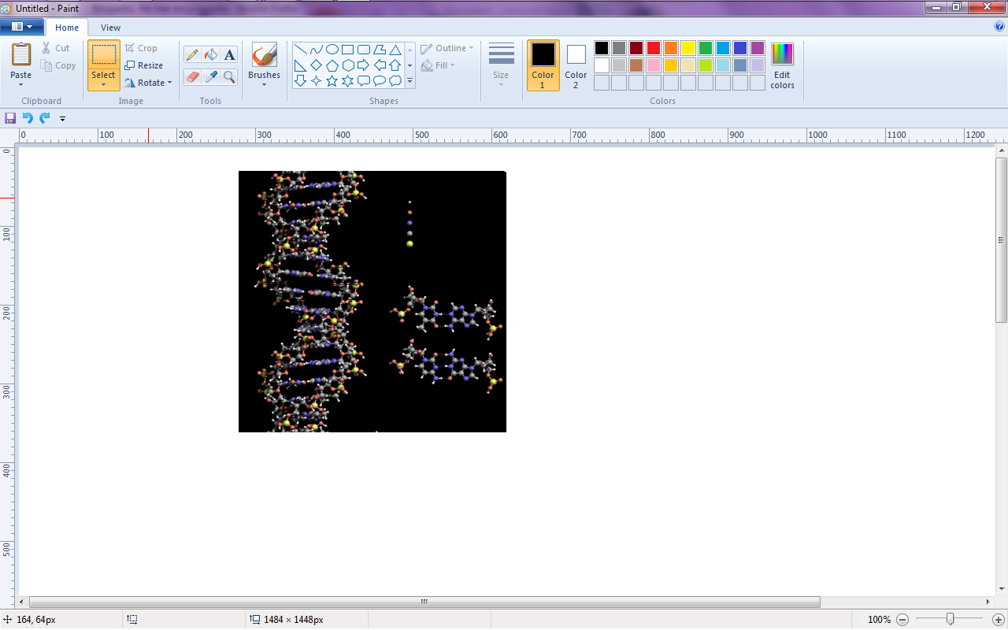
Tool Box
The program comes with the following options in its Tool Box (from left to right in image):
Free-Form Select
Select
Eraser/Color Eraser
Fill With Color
Pick Color
Magnifier
Pencil
Brush
Airbrush
Text
Line
Curve
Rectangle
Polygon
Ellipse
Rounded Rectangle

Slide 32
STEP 1
Creating Digital Artwork by Scanner select Color Choice Before Scanning and Saving
COLOR vs. BLACK AND WHITE always choose B& W until unless colour is necessary
Some journals charge authors for the cost of printing color images – check with each journal first.
The graphic should be scanned as a grayscale image. (Also, files prepared in grayscale require much less computer space than files prepared in color)
For black & white :
Scan/photograph images and save in grayscale format.
For color
Scan/photograph images and save in CMYK mode (Cyan-Magenta-Yellow-blacK) Do not use RGB mode (red, green, and blue.)

Slide 33
Step 2.
Set Resolution Before Scanning and Saving
The resolution is often referred to as dpi (dots per inch). This will determine the ultimate clarity of your file.
The higher the resolution, the better the print quality
Once scanned/photographed and saved, the resolution of a file can never be increased again without distorting the proper print size of the image
For diagrams, drawings and graphs (purely black and white figures with no shades of gray):
Use a resolution of at least 1200 dpi (dots per inch) when scanning. Print out on a photo-quality printer and set your resolution to a minimum of 1200 at 100% final size.
For photographs, radiographs and scanned images:
Set the resolution to at least 300 dpi.

Slide 34
STEP - 3
Set Target Size and Font Before Scanning, Photographing or Saving SIZE & FONT
1 inch = 6 picas. 20 picas = 8.4 cm
Figures or images should be sized to fit the width of 1, 1.5, or 2 columns with no extra white or black space surrounding them (they should be scanned at around the same size you would like them to be published).
Column widths vary by publication. Measure the width of the columns in the journal to which you wish to submit.
Crop out or black out any patient identifiers.
If the figure or image contains text, make sure it’s embedded in the file, and use the Helvetica font
(between 8-12pt.).

Slide 35
Step 4. Name your Files
SAVING & NAMING FILES
Save each piece of artwork separately in TIFF or EPS format.
PowerPoint is also acceptable.
Name figure files using this format: Last Name_Figure1.tif and Last Name Figure2.eps, etc.
“Last Name” is the corresponding author’s last name and the order indicates their order in the manuscript
(and ultimately the figure legend).

Slide 36
Step-5 Submit artwork
Submit figures to the journal according to their preferred method of delivery: online submission, e-mail, disk, etc. as listed in their Instructions for Authors/Author Guidelines.
Compressing figures into one ZIP file speeds submission uploading process.
All electronic art that cannot be successfully uploaded must be submitted on a CD-ROM or an Iomega Zip disk, accompanied by high-resolution laser prints of each image (if available).
Extremely large files may “time out” as you try to upload them to an online manuscript submission tracking system.

Slide 37
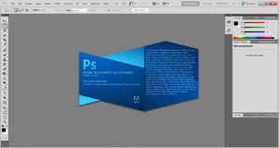
Adobe Photoshop
It is a graphics editing commercially available program developed and published by Adobe Systems Incorporated .
It is very standard tool for graphic design for web use, print layout etc. and has been recognized world-wide as the industry-standard.
Photoshop offers one of the most robust graphics editing experiences available .
Photoshop has the ability to read and write faster and vector image formats such as .EPS, .PNG, .GIF, and .JPEG.
In paper writing it is commonly used for enhancing the dpi(dot per inches) setting for enhancing image qualities and image format conversion.

Slide 38
Photoshop enables the creation, incorporation, and manipulation of vector graphics through its Paths, Pen tools, Shape tools, Shape Layers, Type tools, Import command, and Smart object functions.
Utilization of these tools and commands provides convenience when it is desirable to combine pixel-based and vector-based images in one Photoshop document because it can eliminate the necessity to visit more than one software program and transfer files between them.
Photoshop functionality can be extended by add-on programs called Photoshop plugins like: filter, export, import, selection, automation, etc.
These plugins can either modify the current image or create the all new content.
Examples of few popular plugins are:
Color correction plugins :Alien Skin Software, Nik Software, OnOne Software, Topaz Labs Software, The Plugin Site,etc.
Special effects plugins : Alien Skin Software, Auto FX Software, AV Bros., Flaming Pear Software, etc.
3D effects plugins :Andromeda Software, Strata.

Slide 39
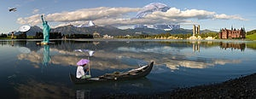
A landscape photo composed and manipulated in Photoshop

Slide 40
Bioinformatics Software
Bioinformatics uses neural network software. Free download.
www.neuralware.com
Scientific writing www.iThenticate.com Plagiarism detection for scientific medical and technical publishers
Medical writing www.watermeadow.com "The text is superb" - Cardiologist
Class VI to Class XI www.meritnation.com Free Tests & NCERT/CBSE Solutions, Free Videos, Animations and more
To get started with PubMed (www, enter one or more search terms.
Search terms may be topics, authors or journals.

Slide 41
Software useful for writing Research paper
Win edt (www.winedt.com)
WinEdt is a powerful and versatile text editor for Windows with a strong predisposition towards the creation of LaTeX documents. It has been extensively tested under Windows XP, Vista, 7, and 8 (32-bit and 64-bit).
MiKTex (MiKTeX is open source)
MiKTeX (pronounced mick-tech) is an up-to-date implementation of TeX/LaTeX and related programs for Windows (all current variants).
TeX is a typesetting system written by Donald Ervin Knuth

Slide 42
Software useful for Typesetting Research paper
LyX (www.lyx.org )
LaTex (www.latex-project.org)
Aurora (http/.elevatorladay.ca )
Text studio (http://texstudio.sourceforge.net/)
Latexeditor (Led)(http://www.latexeditor.org/ )

Slide 43
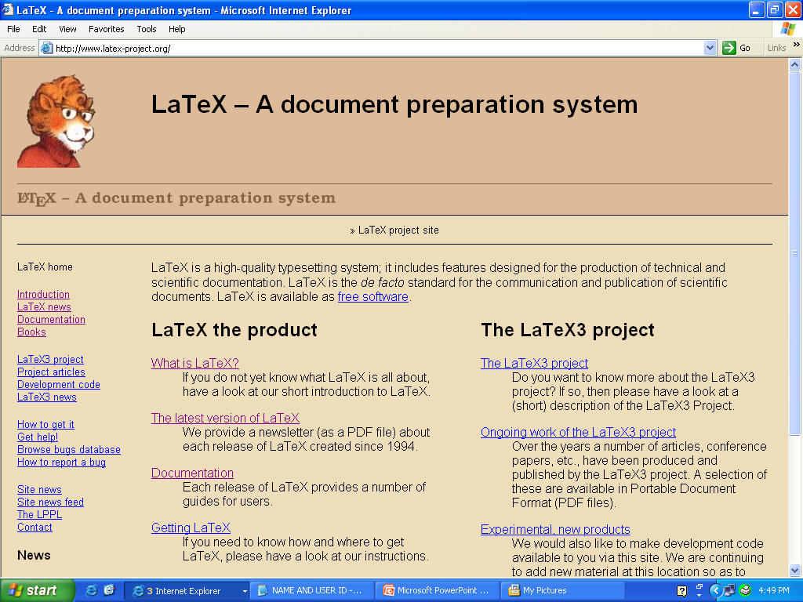

Slide 44
Latex editor (LEd)
LaTeX Editor, called later LEd, is an environment for rapid TeX and LaTeX document development.
It is free to use.

Slide 45
What is LyX?
LyX is a document processor that encourages an approach to writing based on the structure of your documents and not simply their appearance .
LyX is an advanced open source document processor running on Linux/Unix, Windows, and Mac OS X.
It is called a "document processor", because unlike standard word processors, LyX encourages an approach to writing based on the structure of your documents, not their appearance.
LyX lets you concentrate on writing, leaving details of visual layout to the software.
LyX automates formatting according to predefined rule sets, yielding consistency throughout even the most complex documents.
LyX produces high quality, professional output – using LaTeX, an open source, industrial strength typesetting engine, in the background.

Slide 46
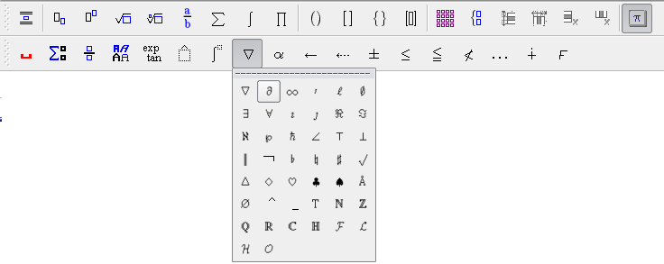
Math toolbars

Slide 47
Why Aurora is good for you
No more mouse-hunting for symbols—enter great-looking math quickly and efficiently using the standard language of scientific typesetting.
Express any scientific concept from mathematics, computer science, chemistry, engineering, and many other areas.
Full integration with Microsoft® Word, PowerPoint®, Visio®, and Excel®.
Built-in LaTeX document converter.
Advanced support for equation numbering.
Works with any Windows application that has an “Insert Object...” function or lets you paste images.

Slide 48
Plagiarism finder softwares
Turntin
Dogcop
Duplichecker
Viper
Plagscan
See Sources
Plagiarism detector
Plagium
Plagiarisma.net
Plag tracker

Slide 49
Thank you
Learn Computer for technical writing

